Slide 1
Swap Space Management
Swapping is a memory management technique used in multi-programming to increase the number of processes sharing the CPU.
It is a technique of removing a process from the main memory and storing it into secondary memory, and then bringing it back into the main memory for continued execution.
This action of moving a process out from main memory to secondary memory is called Swap Out and the action of moving a process out from secondary memory to main memory is called Swap In.

Slide 2
Swap-Space : The area on the disk where the swapped-out processes are stored is called swap space.
Swap-Space Management :
Swap-Space management is another low-level task of the operating system. Disk space is used as an extension of main memory by the virtual memory.
As we know the fact that disk access is much slower than memory access, In the swap-space management we are using disk space, so it will significantly decreases system performance.
Basically, in all our systems we require the best throughput, so the goal of this swap-space implementation is to provide the virtual memory the best throughput.
In these article, we are going to discuss how swap space is used, where swap space is located on disk, and how swap space is managed.

Slide 3
Swap-Space Use :
Swap-space is used by the different operating-system in various ways.
The systems which are implementing swapping may use swap space to hold the entire process which may include image, code and data segments.
Paging systems may simply store pages that have been pushed out of the main memory.
The need of swap space on a system can vary from a megabytes to gigabytes but it also depends on the amount of physical memory, the virtual memory it is backing and the way in which it is using the virtual memory.
It is safer to overestimate than to underestimate the amount of swap space required, because if a system runs out of swap space it may be forced to abort the processes or may crash entirely.
Overestimation wastes disk space that could otherwise be used for files, but it does not harm other.

Slide 4
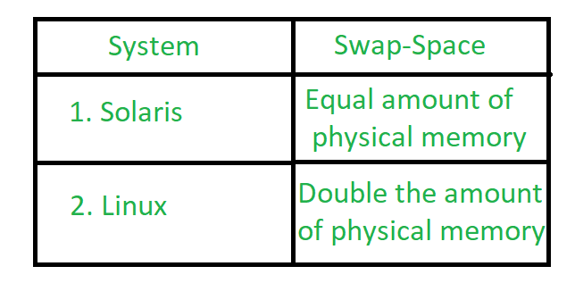
Following table shows different system using amount of swap space:

Slide 5
Explanation of above table :
Solaris, setting swap space equal to the amount by which virtual memory exceeds page-able physical memory.
In the past Linux has suggested setting swap space to double the amount of physical memory.
Today, this limitation is gone, and most Linux systems use considerably less swap space.
Including Linux, some operating systems; allow the use of multiple swap spaces, including both files and dedicated swap partitions.
The swap spaces are placed on the disk so the load which is on the I/O by the paging and swapping will spread over the system’s bandwidth.

Slide 6
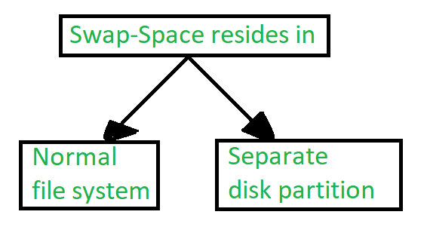
Swap-Space Location :
Location of swap-space

Slide 7
A swap space can reside in one of the two places –
Normal file system
Separate disk partition
Let, if the swap-space is simply a large file within the file system.
To create it, name it and allocate its space normal file-system routines can be used. This approach, through easy to implement, is inefficient.
Navigating the directory structures and the disk-allocation data structures takes time and extra disk access.
During reading or writing of a process image, external fragmentation can greatly increase swapping times by forcing multiple seeks.

Slide 8
There is also an alternate to create the swap space which is in a separate raw partition.
There is no presence of any file system in this place.
Rather, a swap space storage manager is used to allocate and de-allocate the blocks. from the raw partition.
It uses the algorithms for speed rather than storage efficiency, because we know the access time of swap space is shorter than the file system.
By this Internal fragmentation increases, but it is acceptable, because the life span of the swap space is shorter than the files in the file system.
Raw partition approach creates fixed amount of swap space in case of the disk partitioning.
Some operating systems are flexible and can swap both in raw partitions and in the file system space, example: Linux.

Slide 9
Swap-Space Management: An Example –
The traditional UNIX kernel started with an implementation of swapping that copied entire process between contiguous disk regions and memory.
UNIX later evolve to a combination of swapping and paging as paging hardware became available.
In Solaris, the designers changed standard UNIX methods to improve efficiency. More changes were made in later versions of Solaris, to improve the efficiency.
Linux is almost similar to Solaris system. In both the systems the swap space is used only for anonymous memory, it is that kind of memory which is not backed by any file.
In the Linux system, one or more swap areas are allowed to be established.
A swap area may be in either in a swap file on a regular file system or a dedicated file partition.

Slide 10
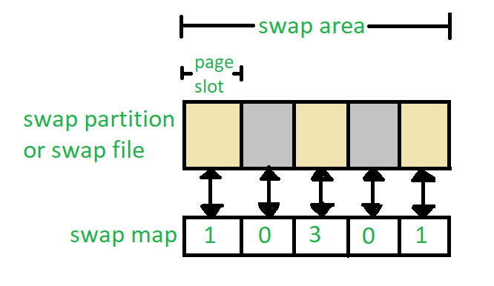
Data structure for swapping on Linux system

Slide 11
Each swap area consists of 4-KB page slots, which are used to hold the swapped pages.
Associated with each swap area is a swap-map- an array of integers counters, each corresponding to a page slot in the swap area.
If the value of the counter is 0 it means page slot is occupied by swapped page.
The value of counter indicates the number of mappings to the swapped page.
For example, a value 3 indicates that the swapped page is mapped to the 3 different processes.

Slide 12
Dynamic Memory Allocation
Memory allocation is a very important part of software development. When the program is loaded into the system memory, the memory region allocated to the program is divided into three broad regions: stack, heap, and code.
Stack region is used for storing program's local variables when they're declared. Also, variables and arrays declared at the start of a function, including main, are allocated stack space. Stacks grow from high address to low address.
Heap region is exclusively for dynamic memory allocation. Unlike stacks, heaps grow from low address to high address.

Slide 13
Code region can be further divided as follows:
BSS segment: stores uninitialized static variables
Data segment: stores static variables that are initialized
Text segment: stores the program's executable instructions

Slide 14
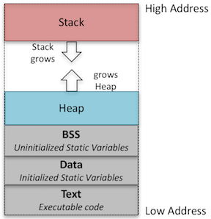
Program Memory Layout

